Slide 1
ARCHITECTURE DESIGN

Slide 2
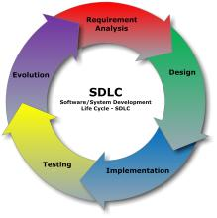
What is Software architecture and design?
Software application architecture is the process of defining a structured solution that meets all of the technical and operational requirements, while optimizing common quality attributes such as performance, security, and manageability.
it is the part of Software (System) developing life cycle.
It is second step of software developing

Slide 3
The difference between architecture and design.
Architecture is the bigger picture: the choice of frameworks, languages, scope, goals, and high-level methodologies (Rational, waterfall, agile, etc.).
Design is the smaller picture: the plan for how code will be organized; how the contracts between different parts of the system will look; the ongoing implementation of the project's methodologies and goals. Specification are written during this stage.

Slide 4
Architecture should be.
User empowerment. A design that supports user empowerment is flexible, configurable, and focused on the user experience. Design your application with appropriate levels of user personalization and options in mind. Allow the user to define how they interact with your application instead of dictating to them, but do not overload them with unnecessary options and settings that can lead to confusion. Understand the key scenarios and make them as simple as possible; make it easy to find information and use the application.
Market maturity. Take advantage of market maturity by taking advantage of existing platform and technology options. Build on higher level application frameworks where it makes sense, so that you can focus on what is uniquely valuable in your application rather than recreating something that already exists and can be reused. Use patterns that provide rich sources of proven solutions for common problems.
Flexible design. Increasingly, flexible designs take advantage of loose coupling to allow reuse and to improve maintainability. Pluggable designs allow you to provide post-deployment extensibility. You can also take advantage of service orientation techniques such as SOA to provide interoperability with other systems.
Future trends. When building your architecture, understand the future trends that might affect your design after deployment. For example, consider trends in rich UI and media, composition models such as mash ups, increasing network bandwidth and availability, increasing use of mobile devices, continued improvement in hardware performance, interest in community and personal publishing models, the rise of cloud-based computing, and remote operation.

Slide 5
Techniques for Architecture and design
Inputs, Outputs, and Design Steps
Identify Architecture Objectives
Scope and Time
Key Scenarios
Architecturally Significant Use Cases
Application Overview
Relevant Technologies
Whiteboard Your Architecture
Key Issues
Quality Attributes
Designing for Issue Mitigation
Crosscutting Concerns
Candidate Solutions
Baseline and Candidate Architectures
Architectural Spikes
Reviewing Your Architecture
Reviewing Your Architecture
Scenario-Based Evaluations
Representing and Communicating Your Architecture Design

Slide 6
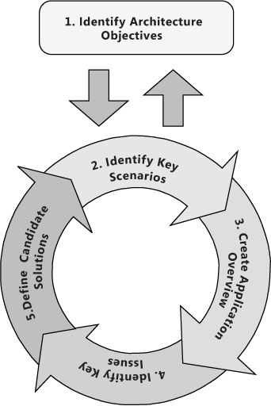
Inputs, Outputs, and Design Steps
Identify Architecture Objectives. Clear objectives help you to focus on your architecture and on solving the right problems in your design. Precise objectives help you to determine when you have completed the current phase, and when you are ready to move to the next phase.
Key Scenarios. Use key scenarios to focus your design on what matters most, and to evaluate your candidate architectures when they are ready.
Application Overview. Identify your application type, deployment architecture, architecture styles, and technologies in order to connect your design to the real world in which the application will operate.
Key Issues. Identify key issues based on quality attributes and crosscutting concerns. These are the areas where mistakes are most often made when designing an application.
Candidate Solutions. Create an architecture spike or prototype that evolves and improves the solution and evaluate it against your key scenarios, issues, and deployment constraints before beginning the next iteration of your architecture.

Slide 7
UML

Slide 8
Activity diagram
An activity diagram shows the flow from activity to activity.
Activity diagram is just like a flowcharts.
It’s used to describe dynamic aspects of the system.
It’s useful for showing what happens in a business process or an operation.

Slide 9
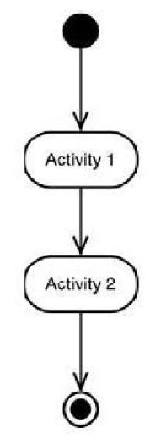
Activity diagram
An activity diagram is designed to be a simplified look at what happens during an operation or a process.
Each activity is represented by a rounded rectangle.
The processing within an activity goes to completion and then an automatic transmission to the next activity occurs.
An arrow represents the transition from one activity to the next.
A starting point and an endpoint.

Slide 10
State diagram
A state diagram is a type of diagram used in computer science and related fields to describe the behavior of systems. State diagrams require that the system described is composed of a finite number of state.

Slide 11
State diagram
the basic elements:
Filled circle, representing to the initial state
Hollow circle containing a smaller filled circle, indicating the final state (if any)
Rounded rectangle, denoting a state.
Arrow, denoting transition.

Slide 12
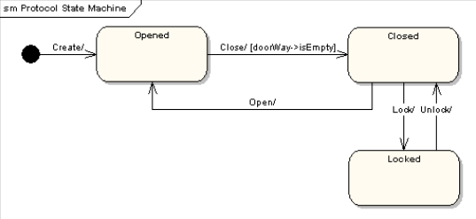
State diagram

Slide 13
class diagram
A class diagram in the Unified Modeling Language (UML) is a type of static structure diagram .a class diagram describes the structure of a system by showing the system's classes, their attributes, operations (or methods), and the relationships among objects.

Slide 14
class diagram
In a class diagram, classes are represented with boxes that contain three compartments : The top compartment contains the name of the class . The middle compartment contains the attributes of the class . The bottom compartment contains the operations the class can execute.
In a class diagram , UML defines the following relationships : Inheritance（is a）、Association(has a)、Aggregation、Composition、Dependency(use a)

Slide 15
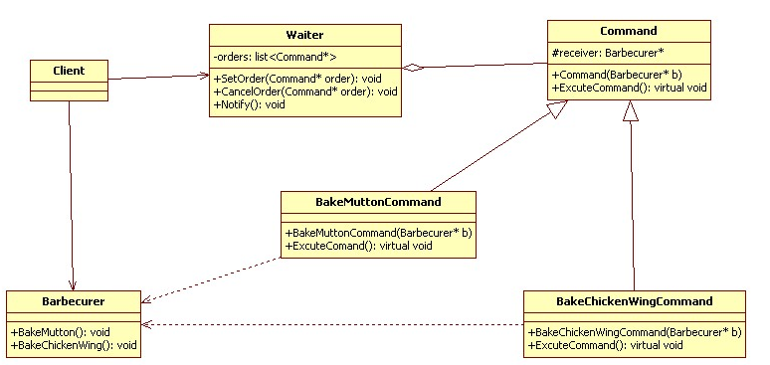
class diagram

Slide 16
Sequence diagram
A Sequence diagram is an interaction diagram that shows how objects operate with one another and in what order. It is a construct of a message sequence chart . A sequence diagram shows object interactions arranged in time sequence.
A sequence diagram shows, as parallel vertical lines (lifelines), different processes or objects that live simultaneously, and, as horizontal arrows, the messages exchanged between them, in the order in which they occur. This allows the specification of simple runtime scenarios in a graphical manner.

Slide 17
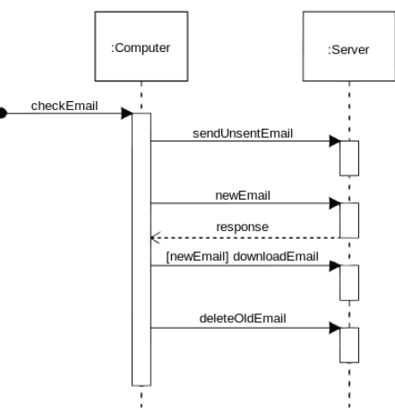
Sequence diagram

Slide 18
Deployment diagram
A deployment diagram in the UML models is the physical deployment of artifacts on nodes. To describe a web site, for example, a deployment diagram would show what hardware components ("nodes") exist (e.g., a web server, an application server, and a database server), what software components ("artifacts") run on each node, and how the different pieces are connected. The nodes appear as boxes, and the artifacts allocated to each node appear as rectangles within the boxes. Nodes may have subnodes, which appear as nested boxes.

Slide 19
Deployment diagram
Deployment Diagram Elements:
1、Node：A node is either a hardware or software element. It is shown as a three-dimensional box shape.
2、Node Instance: An instance can be distinguished from a node by the fact that its name is underlined and has a colon before its base node type.
3、Artifact: This is a product of the software development process. That may include process models, source files, design documents, test reports, etc.
4、Association: In the context of a deployment diagram, an association represents a communication path between nodes.

Slide 20
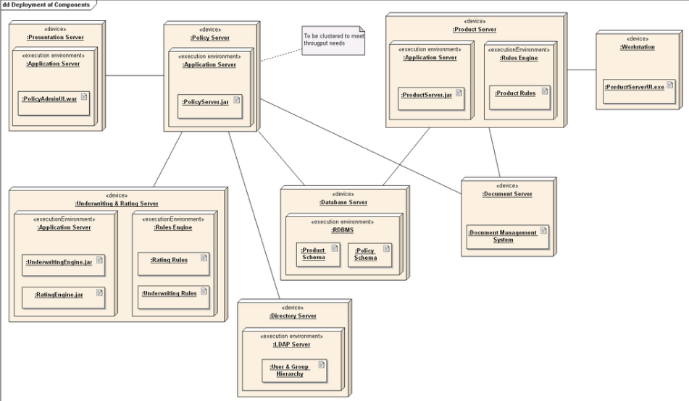
Deployment diagram

Slide 21
COMPONENT DESIGN

Slide 22
Component Design
Component is a modular, deployable, replaceable part of a system that encapsulates implementation and exposes a set of interfaces.
All System processes are placed into separate components.
Component-level design establishes the algorithmic detail required to manipulate data structures, effect communication between software components via their interfaces, and implement the processing algorithms allocated to each component.

Slide 23
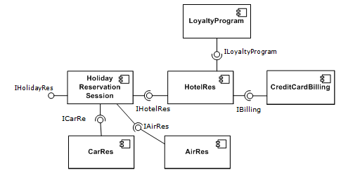
A simple example of several software components

Slide 24
General Principles of Component Design (I)
Determine the features your component will provide.
Determine what objects are required to divide the functionality of the component in a logical fashion.
Design any forms your component will display.
Design the interface – that is, the properties, methods, and events - for each class provided by your component.
Create the component project and test project.

Slide 25
General Principles of Component Design (II)
Implement the forms required by your component.
Implement the interface of each class, provide browser strings for interface members, and add links to Help topics.
As you add each interface element or feature, add code to your test project to exercise the new functionality.
Compile your component and test it with all potential target applications.

Slide 26
INTERFACE DESIGN

Slide 27


INTERFACE DESIGN
???
User analysis
System prototyping
Interface Evaluation
“Interface Design is the process of taking the way a machine works and translating it into the way a person thinks”
By: Michael Connors, User Experience Strategist at Fresh Tilled Soil

Slide 28
Navigability
User Familiarity
Clarity
Consistency
PRINCIPLE
Recoverability
Memory Load
Efficiency
Content Placement

Slide 29
Usability
Functionally
How navigation works?
WYSIWYG
Search Function, Navigation Menu,
Links
ELEMENTS
Visualization
Accessibility
Graphic / Icon
Typography / Text
Color
Memory Load,
Ease of use, learning

Slide 30
Input Controls
Informational
buttons, text fields, checkboxes, radio buttons, dropdown lists, list boxes, toggles, date field
tooltips, icons, progress bar, notifications, message boxes, modal windows
CONTENT
Navigational
Containers
breadcrumb, slider, search field, pagination, slider, tags, icons
Accordions

Slide 31
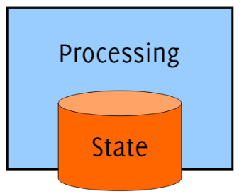
COMPONENT INTERFACE
Provided Interface
Specify and Document the externally visible features (on the public API) offered by the Component
Data Types (Define the component data model)
Operations (Call functionally, Modify State)
Properties (Read Visible state Attributes)
Events (Call-Back, notify about state changes)
Required Interface
A component can be reused only if required interface is satisfied
The platform in compatible:
- Runtime Libraries
- OS / Device Drivers
- Hardware
The Environment is setup correctly:
- Databases
- Configuration files
- File system directories

Slide 32
Replaceable
Extensible
Reusability
CHARACTERISTICS
OF COMPONENT
Encapsulated
Not context specific
Independent

Slide 33
DATABASE DESIGN

Slide 34
Database Design
Database design is the process of producing a detailed data model of database. This data model contains all the needed logical and physical design choices and physical storage parameters needed to generate a design in a data definition language, which can then be used to create a database. A fully attributed data model contains detailed attributes for each entity.

Slide 35
Phases of Database Design
Conceptual design begins with the collection of requirements and results needed from the database (ER Diag.)
Logical schema is a description of the structure of the database (Relational, Network, etc.)
Physical schema is a description of the implementation (programs, tables, dictionaries, catalogs

Slide 36
Models
A data model is a collection of objects that can be used to represent a set of data and operations to manipulate the data
Conceptual models are tools for representing reality at a very high-level of abstraction
Logical models are data descriptions that can be processed by computers

Slide 37
Conceptual model: Entity-Relationship Diagrams
Entities represent classes of real-world objects. Person, Students, Projects, Courses are entities of a University database
Relationships represent interactions between two or more entities
n
1
Lives_In
Person
City
n
Is_Born_In
1

Slide 38
Higher-Order Relationships
A relationship may involve more than two entities
Course
Classroom
Meets
Day

Slide 39
Recursive relationships
Relationships could be mapped from one entity to itself
Manager_off
1
Employee
Manages
n
Subordinate_To

Slide 40
Attributes
Attributes represent elementary properties of the entities or relationships. The stored data will be kept as values of the attributes
n
1
Lives_In
Person
Ssn
Name
Profession
City
Name
Country
Elevation
Population
Moving_Date
Birth_Date
n
Is_Born_In
1

Slide 41
Generalizations (I)
An entity could be seen from many different viewpoints
Each viewpoint defines a set of roles in a generalization
Example below uses SEX to classify the object “Person”
PERSON
Ssn
Name
Address
MAN
Draft_Status
FEMALE
Maiden_Name

Slide 42
Generalizations (II)
A classification could be disjoint or overlapping
An entity could have more than one classification
PERSON
Ssn
Name
Address
SEX
JOB
MAN
Draft_Status
FEMALE
Maiden_Name
Full_Time
Annual_salary
Department
Part_Time
Hour_Rate
Weekly_Hours

Slide 43
Example : Research Project Database
Some employees are researchers
Every project has a leader investigator
Every project must be funded by an agency
A project may include several topics
A topic could appear in several projects
Researchers must produce report(s)
Each employee must have a supervisor

